Slide 1

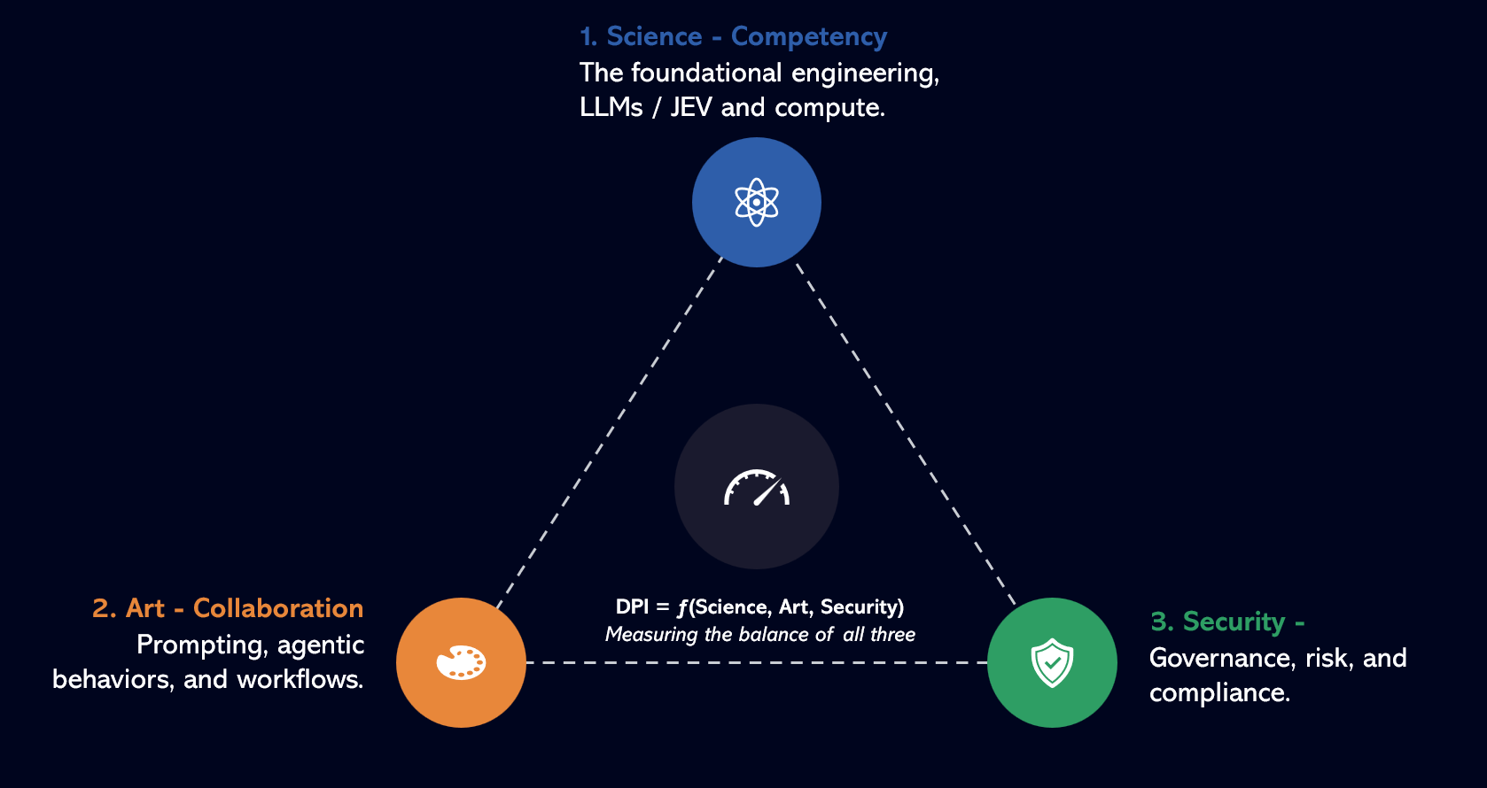
MEASURE INTELLIGENCE BEFORE YOU SCALE AUTONOMY
BEYOND AI AGENTS
The Measurable AI Enterprise
From agent deployment to performance optimization, efficiency gains,
trust and accountable autonomy.
Speaker – PVR, CEO & Managing Director
Notes:
Frame: this is not an agent explainer. The subject is what enterprises manage after agents arrive.

Slide 2
THE AI COST PARADOX
AI is Getting Cheaper.
But Enterprise Intelligence Is Getting More Expensive.
↓ COST PER UNIT OF INTELLIGENCE
COMPUTATIONAL ACTIVITY PER TASK ↑
The A I Cost Paradox
↑
280×
↑
320×
↑
1,000×
↑
73%
Fall in the price of a fixed level of AI performance, in about 18 months
Growth in reasoning-token consumption per organization over 12 months
Token intensity of agentic coding tasks vs. code chat and reasoning
Of organizations exceeded their AI budgets in the past year
The problem is no longer the cost of intelligence. It is the cost of coordinating intelligence at scale.
Notes:
Something very interesting is happening to the economics of artificial intelligence. The cost of delivering intelligence continues to collapse. Yet enterprise AI expenditure is moving in the opposite direction. Why? Because enterprises are no longer asking AI simply to answer questions. We are asking AI to reason. To plan. To retrieve information. To use tools. To access enterprise systems. To collaborate with other agents. To make decisions. And increasingly — to act. Every additional layer of reasoning and action creates another layer of computation. So we have arrived at an apparent contradiction: AI is becoming cheaper, but operating intelligence at enterprise scale is becoming more complex. [Pause] And that changes the question enterprises need to ask. The challenge is no longer AI. The challenge is Enterprise Intelligence.

Slide 3
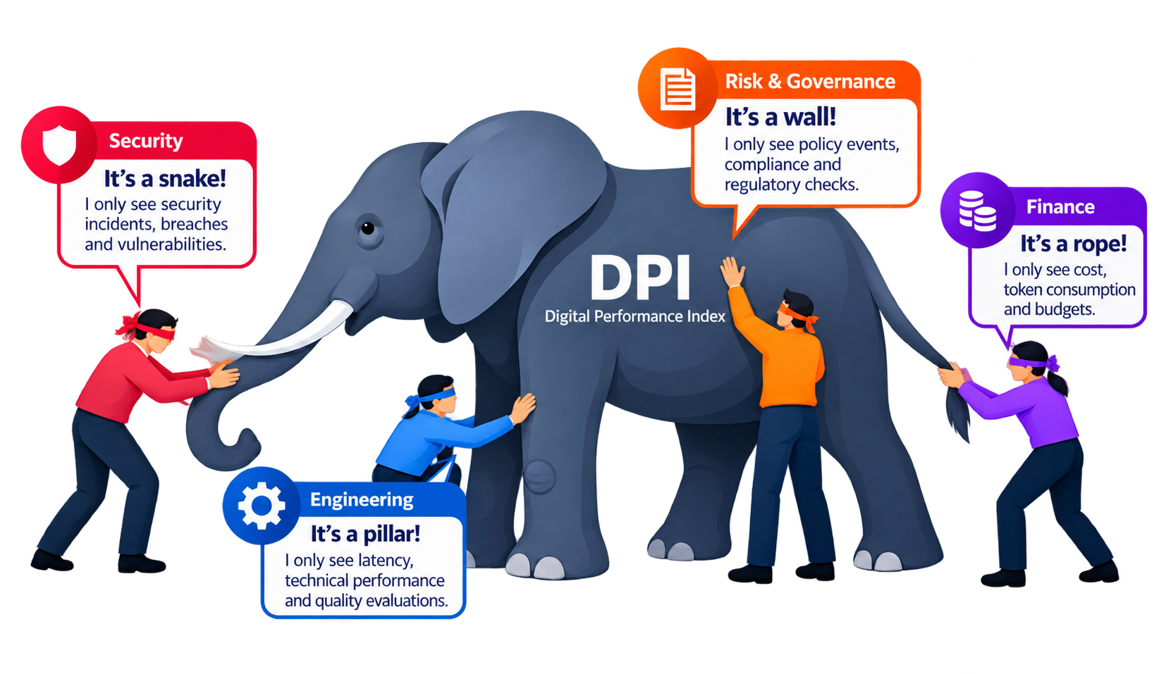
THE NEW OBSERVABILITY GAP
Different Views. An Incomplete Picture.
Each team sees only a part of the AI agent, leading to siloed evaluation and decisions.
THE REALITY
No single team sees the whole elephant - the complete health, performance, risk, cost and business value of the AI agent.
DPI
A unified, multi-dimensional framework to see the full picture and scale with confidence.

Slide 4
The Agent Ecosystem needs to be Observed, Measured and Scaled based on not just the token cost but holistically across multiple dimensions.
1. Science - Competency
The foundational engineering, LLMs / JEV and compute.
2. Art - Collaboration
Prompting, agentic behaviors, and workflows.
DPI = ƒ(Science, Art, Security)
Measuring the balance of all three
3. Security - Controlling
Governance, risk, and compliance.

Slide 5
Intelligenz IT – DPI Engine
A Performance Score for Every Enterprise Agent
The 7- Dimensions of the Scoring Engine
PRODUCTIVITY
QUALITY
EFFICIENCY
Is the agent achieving the objective?
Can we trust the output?
Are actions and tools succeeding?
DPI =
(P × Q^1.5 × E) ×
(G^1.5 × R^2) ×
C × V
GOVERNANACE
RISK & SECURITY
COST
Is the agent operating within policy?
What exposure is being created?
Token efficiency · Compute cost ·
Cost per outcome · Cost trend
VALIDATION
Are required structures, rules and controls being satisfied?
Notes:
Manage an agent like any other critical enterprise resource: a multidimensional health profile, not uptime. If I say 82, your next question is why — so the dimensions and evidence must always be exposed.

Slide 6
THE ENTERPRISE AGENT CONTROL TOWER - ILLUSTRATION
One enterprise. One view of the AI workforce.
Agent health should be observable before agent failure becomes visible.
ENTERPRISE AI WORKFORCE
128 Agents
106 Healthy
14 Watch
6 Optimize
2 Restricted
Agent
Health
Perf.
Quality
Cost
Security
Gov.
Trend
78
Claims Agent
Procurement Agent
92
94
96
87
95
97
↑
Performance
Strong
Quality
Watch
Cloud Operations Agent
86
91
88
71
90
92
→
Token efficiency
Strong
Claims Agent
78
83
74
89
72
81
↓
Execution
Strong
Security
Watch
Customer Agent
69
85
68
62
74
70
↓
Governance
Healthy
Validation
Weak
LAST 30 DAYS · CLAIMS AGENT
Token cost ↑ 18% · Validation failures ↑ · Business output stable
RECOMMENDED ACTION
84
83
81
78
The agent still works. But its efficiency and control are deteriorating.
Improve validation before increasing autonomy.
Notes:
One interface instead of five products and five opinions. Scorecards configurable by role and domain; management experience consistent. Claims Agent still works — but validation deteriorating, security exceptions rising, token cost up 18%, business output flat.

Slide 7
The Scoring Layer Seamlessly Integrates Into Any Agent Ecosystem.
INGESTED EVIDENCE
Existing AI agents
Tool calls, LLM traces, quality evaluations, policy events, incidents and cloud / AI cost.
↓
Existing orchestration / runtime
This is not yet another observability stack.
Iti is an interpretation layer for the evidence enterprises already generate.
↓
API Interface (Open Telemetry, REST APIs, and MCP integrations)
Designed to work with existing observability, validation, security, governance and cost tooling rather than replacing it.
↓
AGENT SCORING LAYER
↓
Enterprise Agent Dashboard
Notes:
Not another observability stack. An interpretation layer across evidence the enterprise already generates — connected through MCP, APIs and telemetry.

Slide 8
Every agent becomes accountable to a contract.
The business sets the terms, the scoring layer holds each agent to them, and leaders act on evidence instead of incidents.
TODAY
THE MECHANISM
WITH THE CONTRACT
AUTONOMY
Granted at deployment
PERFORMANCE CONTRACT
Business sets the terms
Outcome · Quality · Reliability · Cost
Security · Governance · Escalation
AUTONOMY
Earned against the contract
COST
Discovered on the invoice
↓
COST
Budgeted per outcome
AGENT SCORING LAYER
Measures every agent against its terms
→
→
RISK
Found after the incident
RISK
Visible before failure
↓
EVIDENCE-BASED DECISION
Leaders act before agents fail
ACCOUNTABILITY
Split across teams
ACCOUNTABILITY
One shared score
Notes:
Define the contract before the agent receives responsibility. The scoring engine measures the agent against it.

Slide 9
Autonomy becomes a managed enterprise decision.
Every agent operates at the level of autonomy its evidence has earned, and the enterprise can raise or withdraw it at any time.
EVIDENCE-BASED DECISION · FOUR LEVELS OF AUTONOMY
04
SCALE
Earns more scope and volume
WHEN Evidence holds on all 7 dimensions
03
TRUST
Acts alone within policy
WHEN The contract is met consistently
02
OPTIMIZE
Supervised while fixes land
WHEN It works, but cost or quality drifts
Today: Claims Agent, score 78
01
RESTRICT
Human approves every action
WHEN The contract is breached
LESS AUTONOMY
Evidence moves every agent up or down
MORE AUTONOMY
Notes:
If the audience remembers only three things, these are them.

Slide 10
The future of enterprise AI will not be measured by how many agents we deploy.
It will be measured by how confidently we can decide which agents to trust, optimize, restrict and scale.
Every agent observable.
THE MEASURABLE AI ENTERPRISE
Every score explainable.
Every risk visible.
Every optimization evidence-based.
Every increase in autonomy deliberate.
BEYOND AGENTS
Measure Intelligence Before You Scale Autonomy.
Notes:
Close on the two sentences, then the line: measure intelligence before you scale autonomy. Pause between each.

Slide 11
Feel Free To Connect With Us For A Demo
Of DPI In Action
Thank You !
Notes:
If the audience remembers only three things, these are them.

